Slide 1
Exceptions & File I/O:Read
Module 1: 16

Slide 2
Objectives
Exception Handling
File I/O - Reading Files

Slide 3
Errors
A compile-time error occurs when there is a syntactical error or the compiler identifies code that cannot execute.
A run-time error occurs while the program is executing when it is asked to access memory that is inaccessible or perform an operation of which it is not capable.
Run-time errors often result in an Exception. An exception is an event that occurs during the execution of a program that disrupts the normal flow of the program’s instructors. .An exception is represented by an object of type Exception that contains information about the error.

Slide 4
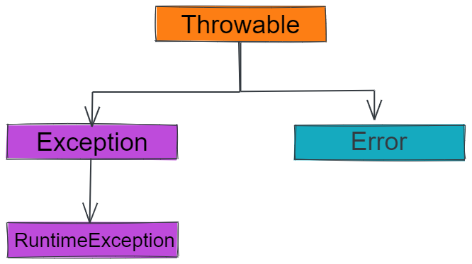
Throwables
All Exceptions and Errors in Java are subclasses of the class Throwable.
Errors are used by the JVM to indicate errors that are associated with the runtime environment, such as running out of memory or other resources. Errors occur only at runtime and it is not possible for an application recover from these errors..
Exceptions are anomalous situations that occur while a program is executing. It is what happens when something is unexpected or goes wrong. For example, trying to parse a String “ABC” into a number. Exceptions can be handled and recovered from.
Exceptions | Errors
1. Possible to recover | 1. Impossible to recover
2. Can be caught and handled | 2. Should not be handled
3. Occur at compile or runtime | 3. Occur at runtime
4. Caused by the code | 4. Caused by the running environment

Slide 5
Exception
Checked Exceptions must be caught with a try...catch.
java.lang.Exception
When calling a method that has a checked exception then the possible exception it can throw must either be caught and dealt with using a try...catch or the method calling it must itself throw an exception of that type.
ClassNotFound
FileNotFound
SqlException
Runtime Exceptions can be thrown from any method and do not have to caught with a try...catch.
java.lang.RuntimeException
ArrayIndexOutOfBoundsException
NullPointerException
ClassCastException
NumberFormatException
NoSuchElementException

Slide 6
Exception Handling
Exception Handling is dealing with unexpected problems in an application so the program does not crash.
If exceptions are not handled, then the application will terminate (crash).
When an unexpected event happens in Java an Exception is Thrown. The thrown exception in Java is an Object that contains details about what happened and a Stack Trace that details where it occurred in the code. These Exception objects can be caught and steps taken to deal with the error, like allowing the user to select a different file or provide different input.
Exceptions are caught and dealt with using a Try...Catch block.

Slide 7
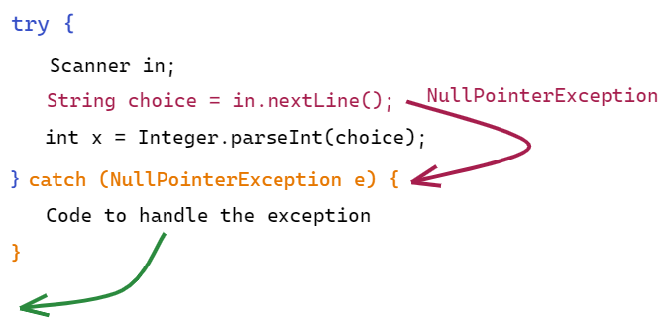
Try…Catch Block
Risky code is surrounded with a try...catch. The try identifies a block of code that may cause an exception, and the catch block identifies a block of code to run if an exception occurs. When an exception occurs in the try, all following lines of code are skipped and the catch is immediately executed.
Visual Explanation

Slide 8
try { risky code } catch (NullPointerException e) { code to handle a NullPointerException } catch (FileNotFoundException e) { code to handle a FileNotFoundException } catch (Exception e) { code to handle any other Exception } finally { code in finally will always be executed }
The try block identifies a block of code that may throw an exception that should be handled.
Multiple catch statements can be chained to handle different exceptions from the same try block. The first matching catch will be executed, so multiple catch statements must be organized in least to most specific.
The optional finally block identifies code that will always be run whether or not an exception is thrown.

Slide 9
Throw and Throws
Exceptions can be thrown manually using the throw keyword. The throw keyword is a statement of code.
throw new MyException();
A method may indicate that it can thrown a checked exception using the throws keyword. The throws keyword is part of the method signature.
public void myMethod() throws MyException

Slide 10
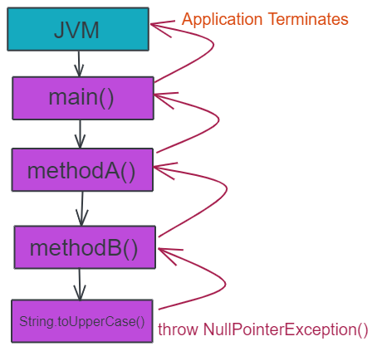
Call Stack
Each method called becomes part of the Call Stack. When an Exception is thrown it is passed up through each level of the call stack. At each level it can be caught and handled by a try...catch().
If the exception is thrown up the stack past the main() method to the JVM then the application terminates (crashes).

Slide 11
File I/O
java.io.File
.exists() .isFile()
File myFile = new File(pathToFile);
File can be passed to Scanner as an input stream.
try (Scanner fileScanner = new Scanner(file)) {
while (fileScanner.hasNextLine()) {
String line = fileScanner.nextLine();
} catch (FileNotFoundException ex) {
}

